Slide 1
(SAMPLE) ORAL PRESENTATION
By Mace Windu

Slide 2
Presentation Question:
Why doesn’t Obi Wan Kenobi kill Anakin Skywalker on Mustafar when he had the chance?

Slide 3
Introduction
The third film in the first Star Wars trilogy ‘The Revenge of the Sith’ is the culmination of the story of Anakin Skywalker’s transformation into Darth Vader, and ends with a fight scene on the volcanic planet of Mustafar which Camille Paglia argues is one of the high points of modern art.

Slide 4
Although Obi Wan Kenobi has been instructed to kill Anakin, during the final scene he cannot.
I will argue that there are four main reasons why:
1) his love for Anakin as a friend
2) his pity for Anakin’s transformation
3) his compassion for all living things
4) his inability to believe that Anakin is truly ‘evil’

Slide 5
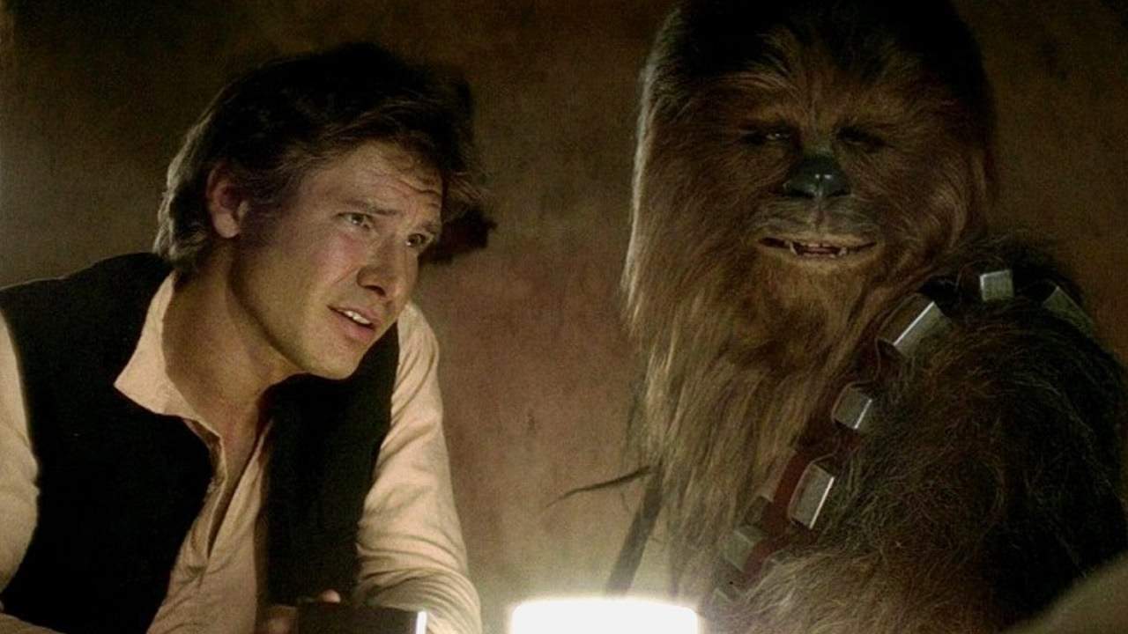
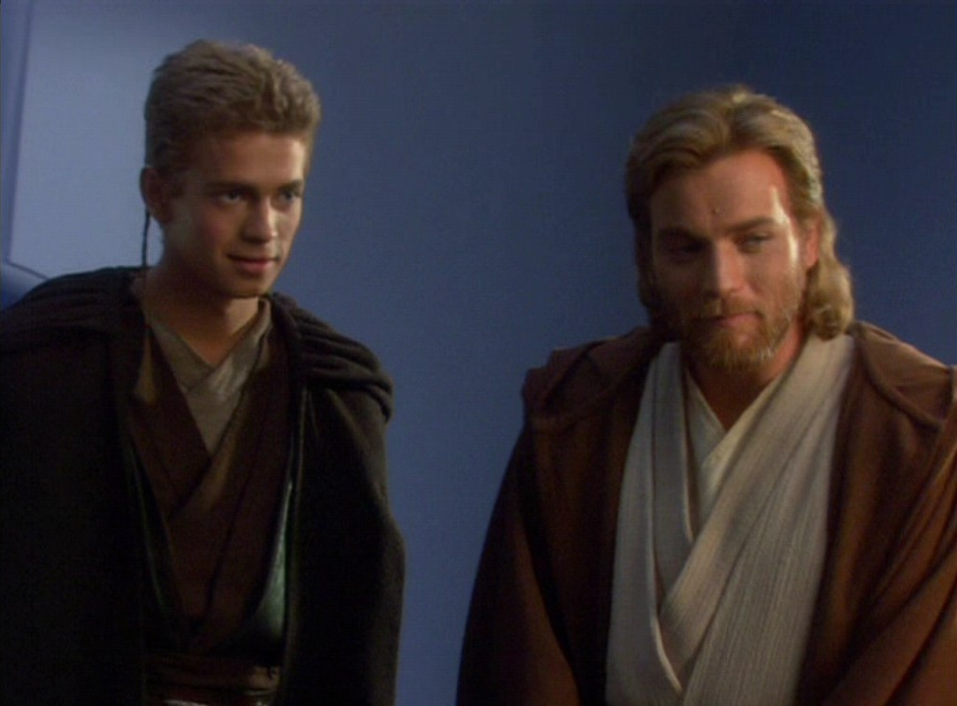
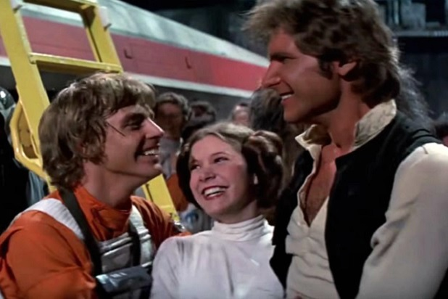
Friendship is something to be honoured in Star Wars

Slide 6
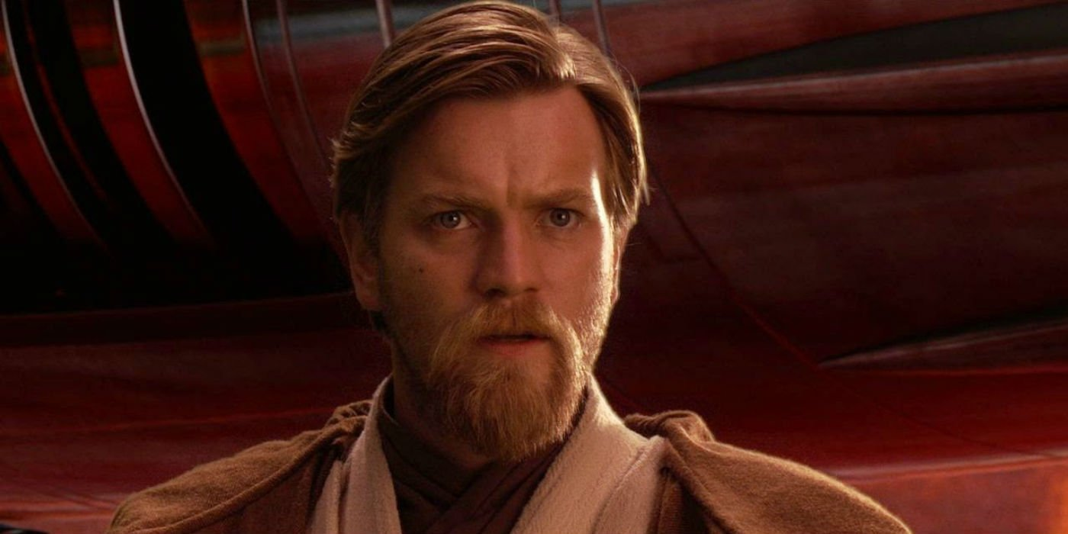
Pity / Mercy / Compassion: the Jedi are taught to be compassionate

Slide 7
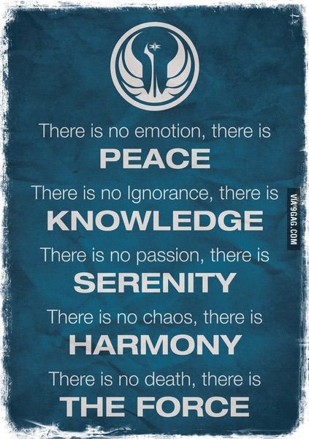
The Jedi Code: respect for life and for all living things

Slide 8
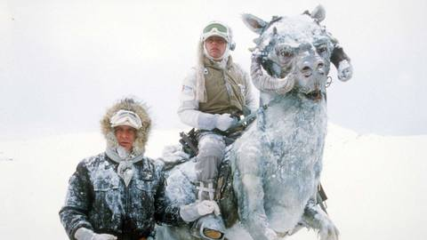
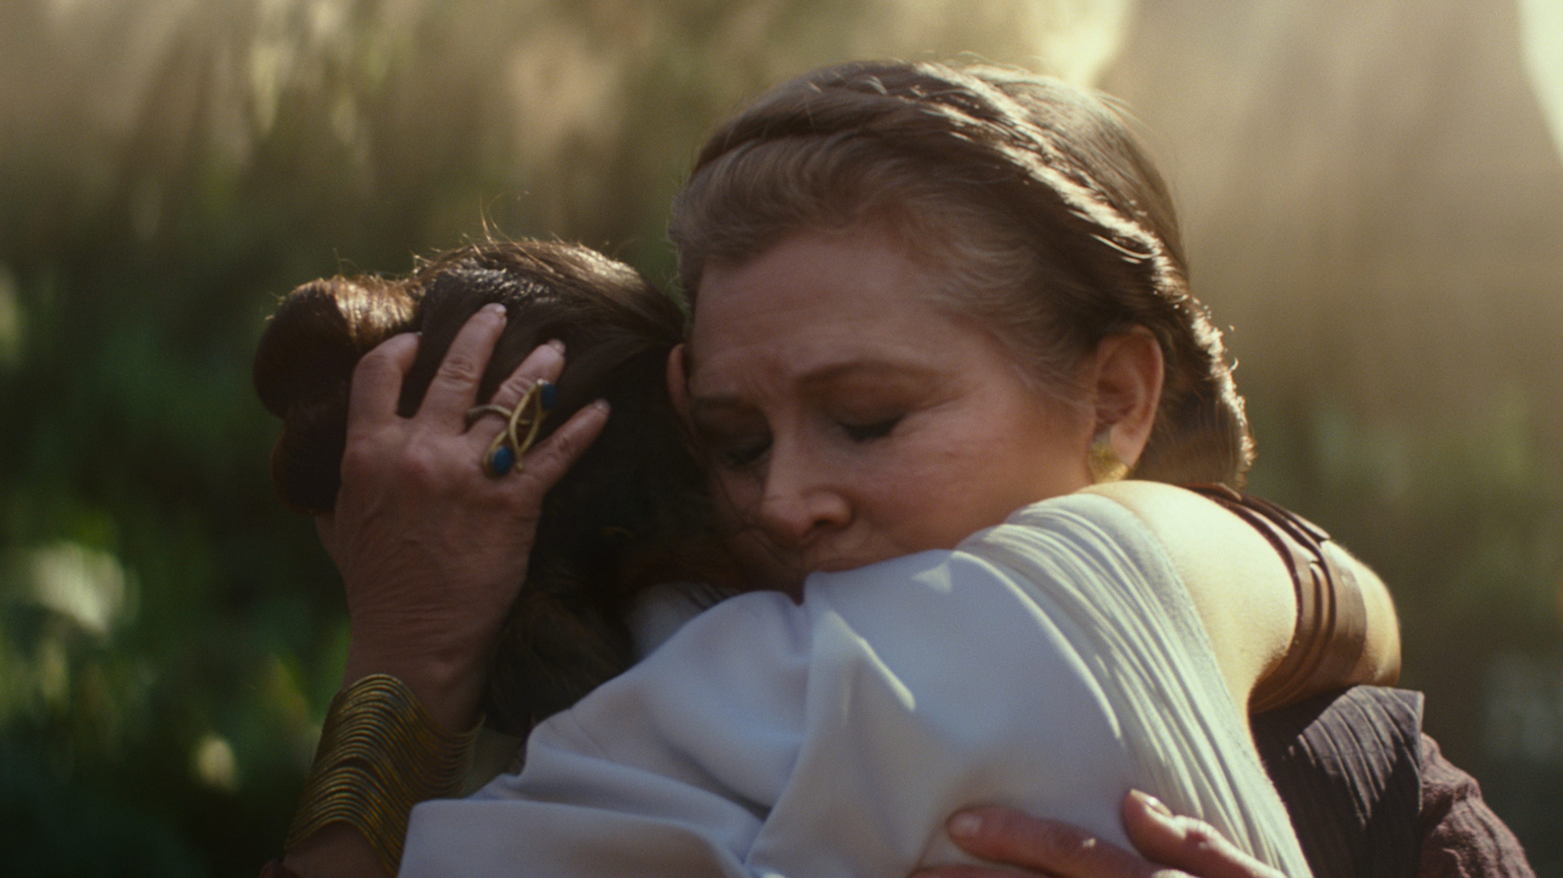
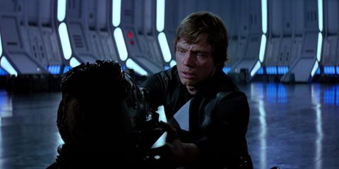
Hope as a central concept in Star Wars

Slide 9
CONCLUSION
Thus, it can be quite confidently argued that there are a number of reasons why Obi Wan both cannot and does kill his former pupil and friend Anakin Skywalker, even when instructed to do so. First is his affection for Anakin, a result of years spent together. Secondly, Obi Wan takes pity on his former’s friend’s suffering and cannot bring himself to perform this final act of cruelty towards someone in pain. Third, as a Jedi, Obi Wan has respect for all life, even when it is seemingly ‘wicked’ or ‘evil’, which leads on to our fourth point, which is that Obi Wan may not actually believe Anakin is truly evil, and thus cannot kill him. The final scene on Mustafar thus leaves us with many tantalising and thought-provoking questions regarding the concepts of duty, conscience and morality, making the film a true masterpiece.

Slide 10
REFERENCES
Insole, C. (2008). ‘The Irreducible Importance of Religious Hope in Kant’s Conception of the Highest Good’. Philosophy Vol. 83, No. 325
Miller & Sprich. (1981). ‘The Appeal of "Star Wars": An Archetypal-Psychoanalytic View’. American Imago Vol.8 No.2 (Summer 1981)
Paglia, C. (2012). ‘George Lucas’ Force’. The Chronicle of Higher Education. October 15 2012

Slide 11
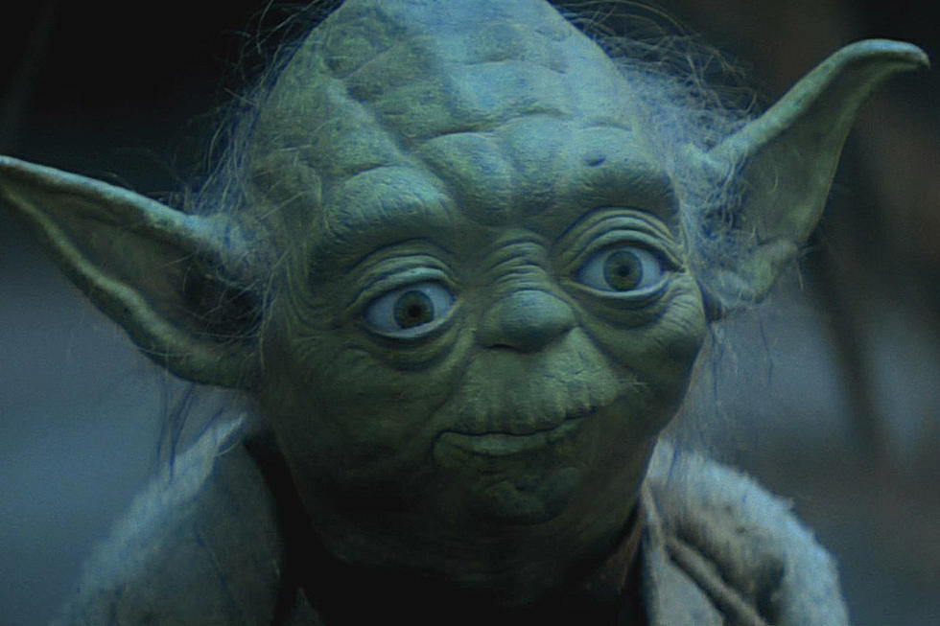
Thank you for listening. Any questions?

